Slide 1
Network Slicing

Slide 2


Network Slicing
To support multiple applications
Virtualization layer to support the slicing
Slice 1
Smartphones
Slice 2
Auto Driving
The virtualization layer may be attacked
Slice 3
IoT

Slide 3

Network Services
Network Provider
Pay for network service
Content
Customer

Slide 4

Network Services
Network Provider
Pay for a customized network
Pay for network service
Video
Customer

Slide 5


Network Requirements
More stable bandwidth
Higher bandwidth
Video Streams
Lower latency
Vehicle Networks
More stable bandwidth
Lower latency
Audio Calls

Slide 6
Scenarios
Application 1
(video stream)
Application 2
(vehicle)
Application 3
(audio calls)
Control
Plane
Network Slicing Platform
1
5
2
4
1
1
5
5
3
Virtual Network
400 Mbps
192.168.1.0/24
10 Mbps
10.1.1.0/24
100 Mbps
172.68.1.0/24
2
4
1
5
Physical Network
3

Slide 7
Scenarios
Application 1
(video stream)
Control
Plane
Applications can use the virtual networks as their own OpenFlow networks
1
5
3
Virtual Network
400 Mbps
192.168.1.0/24
10 Mbps
10.1.1.0/24
100 Mbps
172.68.1.0/24
2
4
1
5
Physical Network
3

Slide 8
Network Slicing Supports
Customized Switches and Links
Customized IP Address Ranges
Customized Bandwidth and Latency

Slide 9
OpenVirtex Architecture
VN manager
VN controller
IP:A2
Port:B2
Libera Network hypervisor
IP: A1 Port: B1

Slide 10
VN Manager
Create a specific topology and virtual network interfaces (NIs)
VN Controller 1
VN Controller 2
VN Controller 3
V
V
V
mapping
Can be OpenFlow, white-box, and P4 switches

Slide 11




VN Controller
After VN Manager create virtual networks topology, we can use any OpenFlow controller to control the virtual networks
Different controllers should use different IP+port pairs

Slide 12
Libera Architecture
VN manager
VN Controller
VNM handler
Flexibility
Virtual NI
Scalability
vSwitch
vSwitch
wildcard
Virtual port
Virtual port
host
Virtual link
hop
host
NI mapping Switch Port Link Flow rule
LITE
Physical NI
VM migration support
Physical port
Virtual link
Physical port
LITE reconfiguration
Switch abstraction protocol (OpenFlow)
Switch abstraction protocol (While-box)
Physical network
OpenFlow Switch
White-box Switch

Slide 13
Virtual NI Layer
VN Controller
vSwitch
Control channel
Message handler
NI mapping

Slide 14
NI Mapping Layer
Controllers install forwarding rules into virtual switches
NI mapping layer maps the forwarding rules to physical switches
Forwarding rules
vSwitch
NI Mapping Layer
Physical layer

Slide 15
Physical NI Layer
Abstraction modules for different protocols
OpenFlow 1.0 abstraction
OpenFlow 1.3 abstraction
P4 abstraction
White-box abstraction
OpenFlow 1.0 switch
OpenFlow 1.3 switch
White-box switch
P4 switch

Slide 16
Scalability
Reduce the number of forwarding rules to save TCAM space as well as control messages
Wildcard
LITE
192.168.1.1/24, port 80
10.1.1.1/24, port 80
192.168.1.1
192.168.1.2
*, port 80
10.1.1.1
10.1.1.2
Group I
Group II

Slide 17
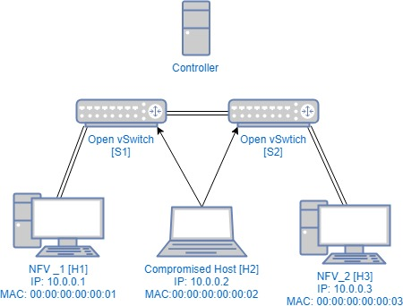
Topology Discovery in OpenFlow
Broadcast the LLDP messages
Report the received LLDP

Slide 18
Virtual Topology Discovery
VN Controller
LLDP message
LLDP response from vSwitch 5
Libera Network Slicing Platform
1
5
Virtual Network
Topology discovery
2
4
1
5
Physical Network
3

Slide 19
Customized IP Address Ranges
VN Controller 1
VN Controller 2
192.168.1.1/24 → 1
10.1.1.1/24 → 2
Libera Network Slicing Platform
192.168.1.10
10.1.1.11
2
4
1
5
3

Slide 20
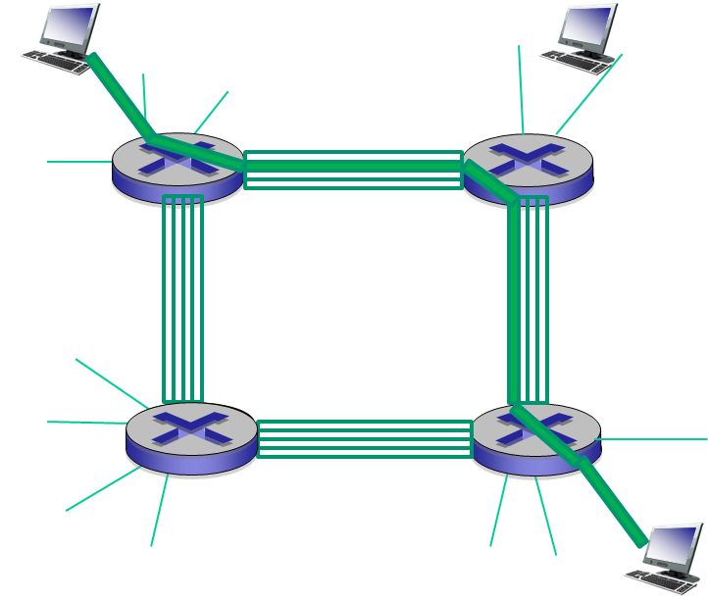
Bandwidth Slicing
Network bandwidth is divided for different tenants
The idea is borrowed from circuit switching

Slide 21
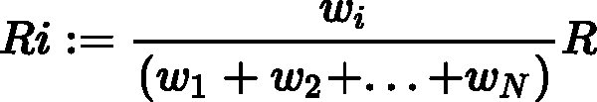
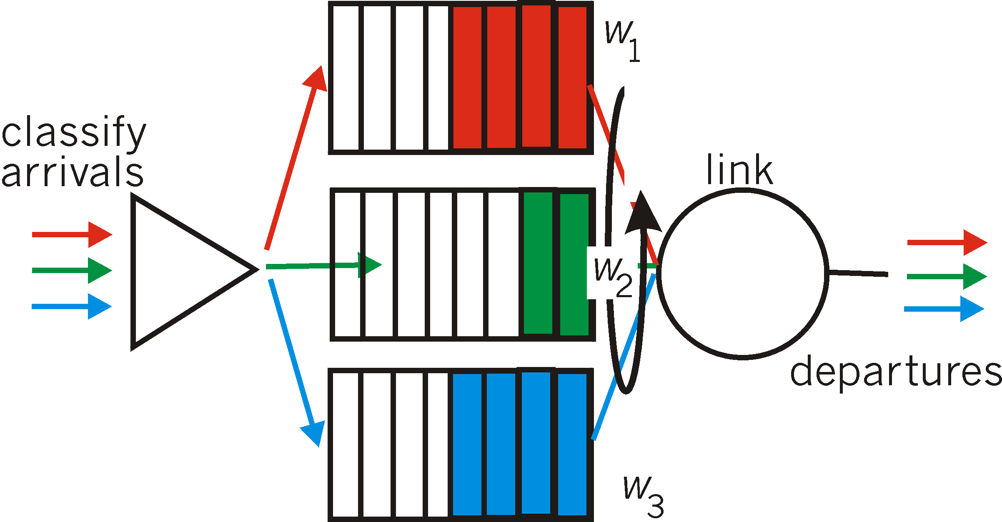
Priority Queue
Weighted Fair Queuing (WFQ):
generalized Round Robin
each class gets weighted amount of service in each cycle
real-world example?

Slide 22
Priority Queue
How to setup priority queue?
Depend on switches
Take OVS as example

Slide 23
OVSDB Management
vBridge
vPort
Queue
Forwarding rules
Controller
OVSDB
Mgmt
OpenFlow
ovsdb-server
ovs-vswitchd
Forwarding Path

Slide 24
Priority Queue in OVS
Create priority queues
ovs-vsctl set port eth0 qos=@newqos -- \
--id=@newqos create qos type=linux-htb \
other-config:max-rate=1000000000 \
queues:123=@vif10queue \
queues:234=@vif20queue -- \
--id=@vif10queue create queue other-config:max-rate=10000000 -- \
--id=@vif20queue create queue other-config:max-rate=20000000
Assigned bandwidth
Setup forwarding rules
The matched flows are forwarded to the queues
ovs-ofctl add-flow br0 nw_dst=192.168.1.10,actions=set_queue:123,normal
ovs-ofctl add-flow br0 nw_dst=10.1.1.11,actions=set_queue:234,normal

Slide 25
Security Issues in Network Slicing
Match
high priority queue
(waiting area)
arrivals
departures
classify
link
(server)
low priority queue
(waiting area)
Action = setQueue
We can attack network slicing by using fake packets

Slide 26
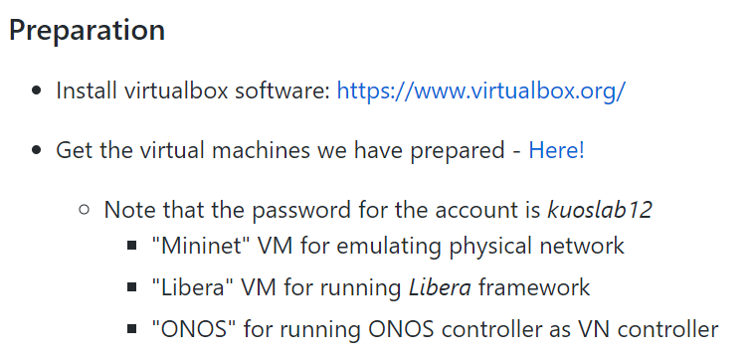
Libera: Network Hypervisor for Programmable Network Virtualization in Datacenters
Github: https://github.com/os-libera/Libera

Slide 27
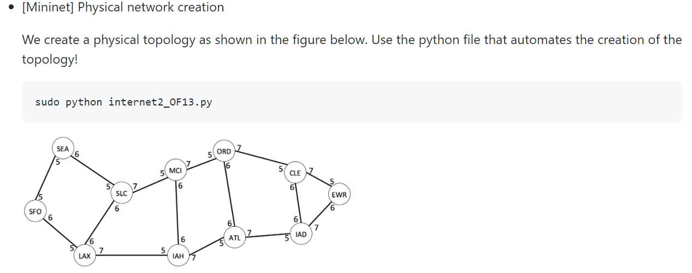
Libera: Network Hypervisor for Programmable Network Virtualization in Datacenters

Slide 28
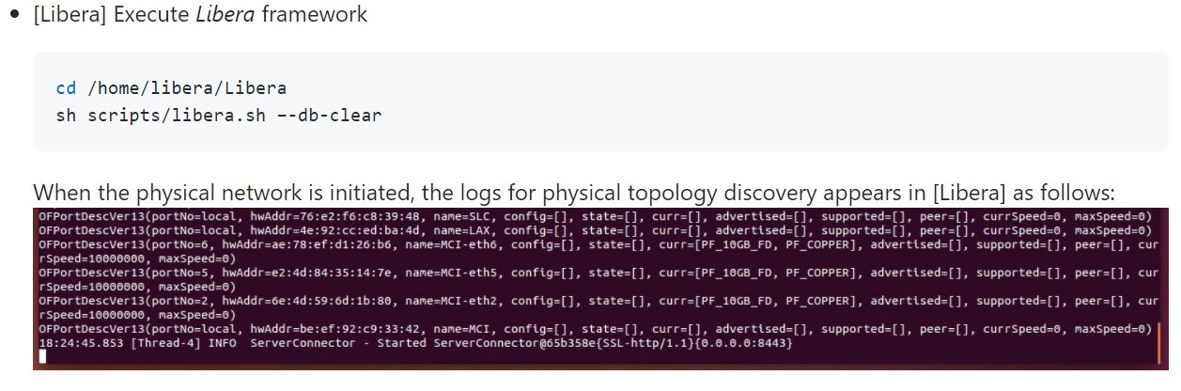
Libera: Network Hypervisor for Programmable Network Virtualization in Datacenters

Slide 29
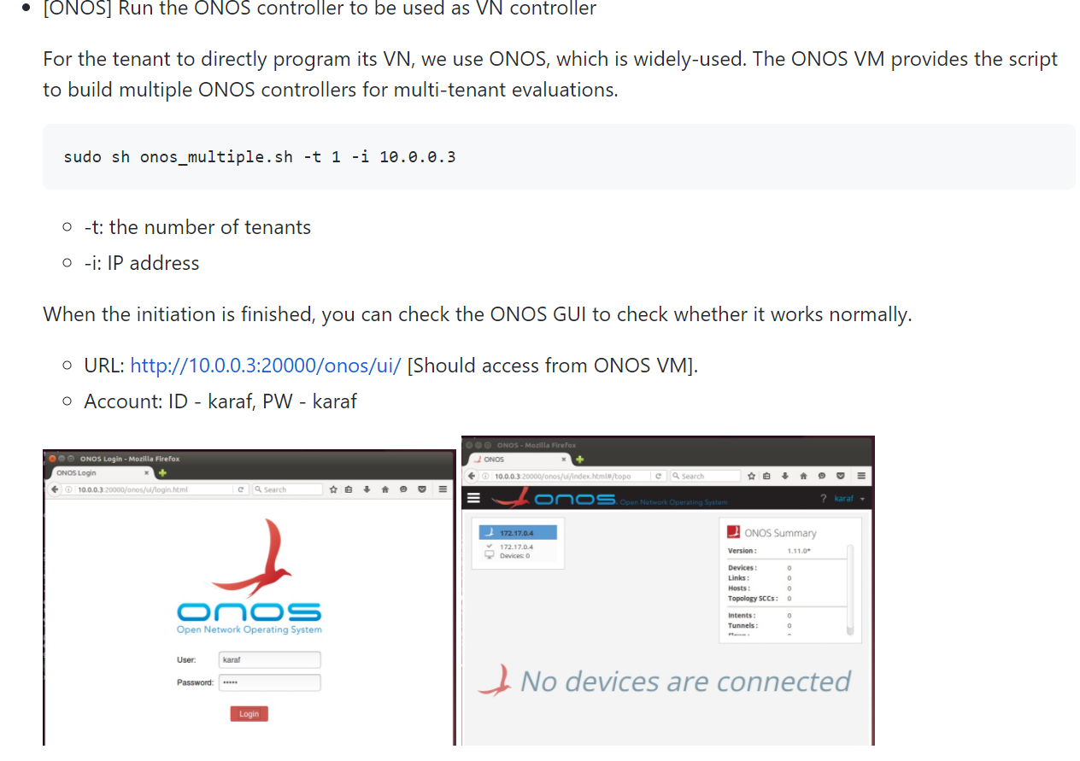
Libera: Network Hypervisor for Programmable Network Virtualization in Datacenters

Slide 30
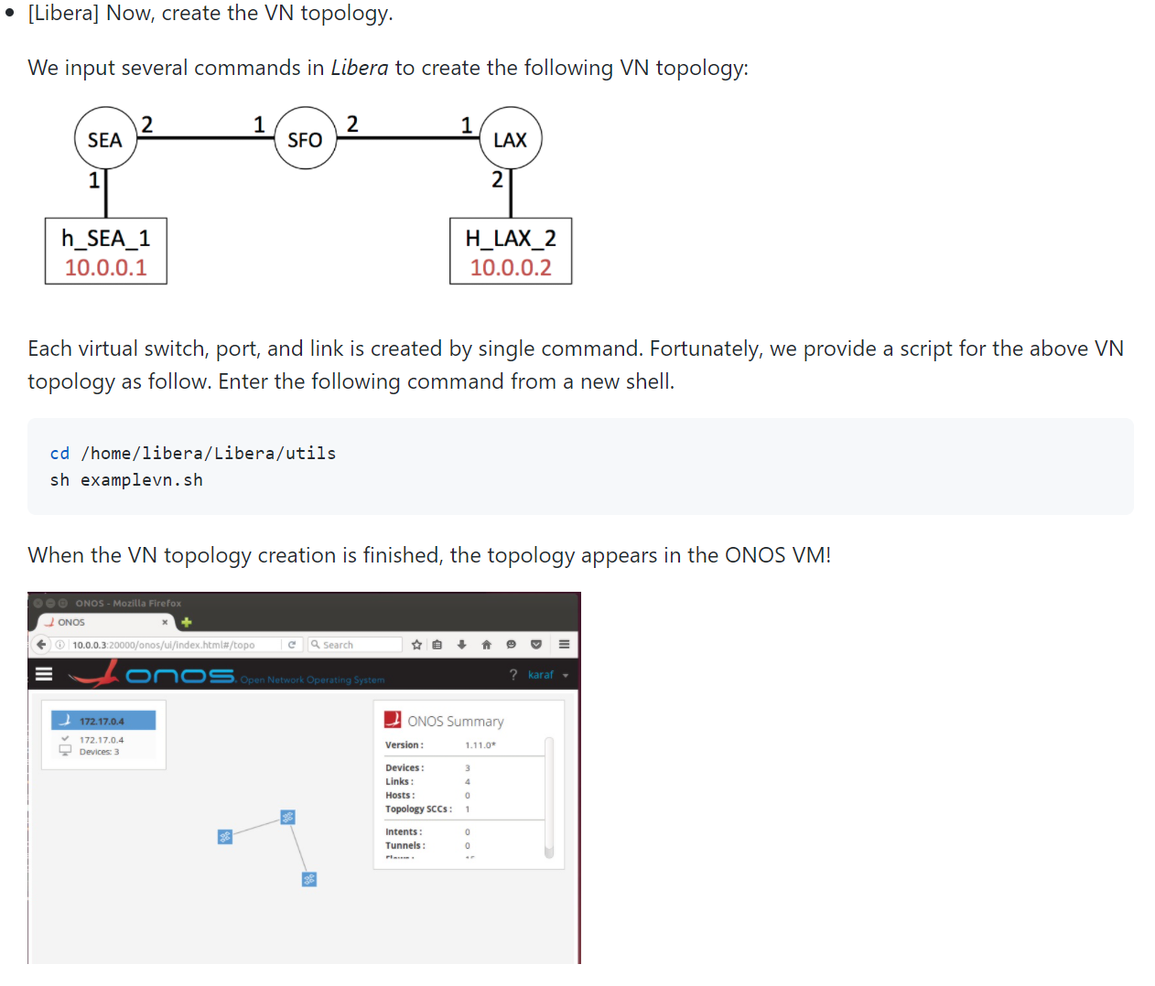
Libera: Network Hypervisor for Programmable Network Virtualization in Datacenters

Slide 31
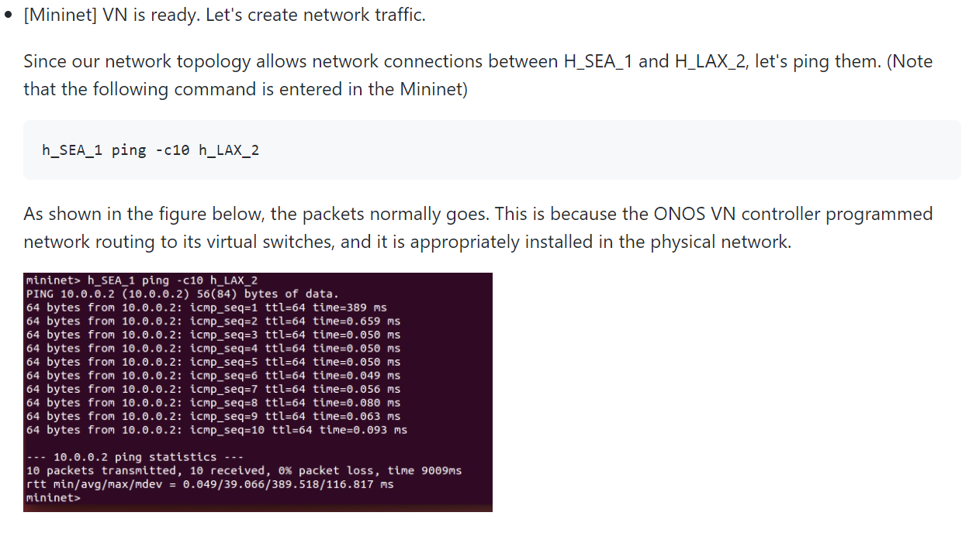
Libera: Network Hypervisor for Programmable Network Virtualization in Datacenters

Slide 32
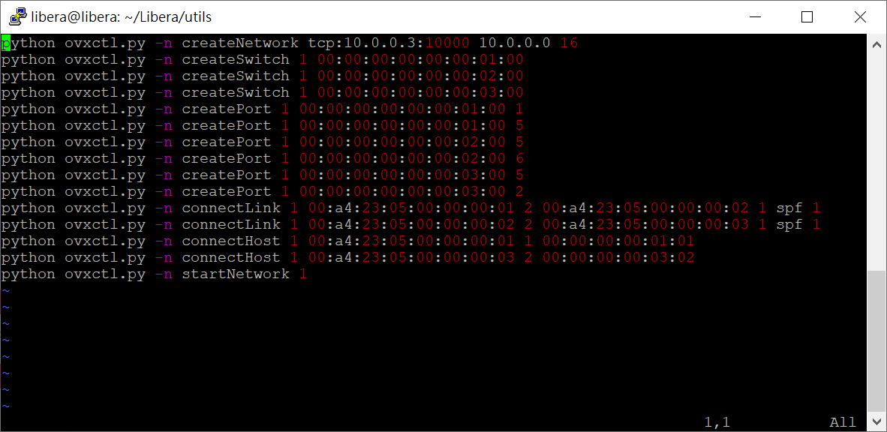
Libera: Network Hypervisor for Programmable Network Virtualization in Datacenters

Slide 33
Network Slicing in NFV
Tenant 1
Tenant 2
Tenant 3
CPU
RAM
Storage

Slide 34
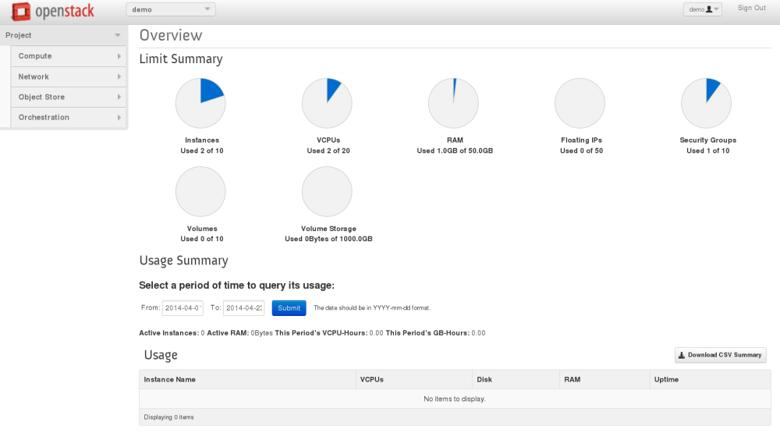
Network Slicing in NFV

